Slide 1
How old is he / she?
?

Slide 2
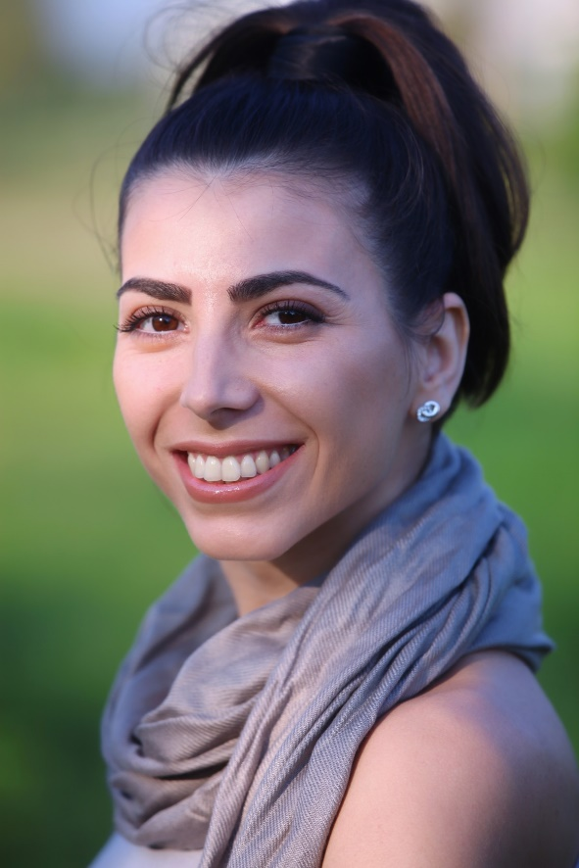
How old is she?
39
She’s thirty-nine.

Slide 3
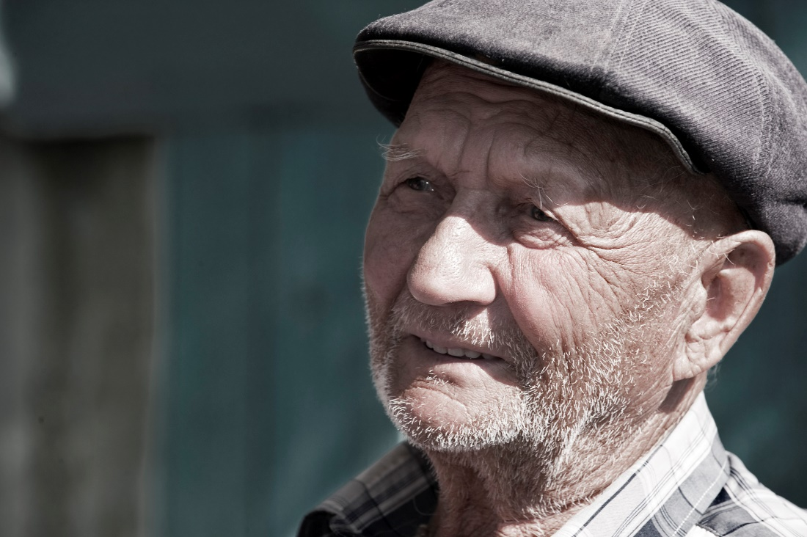
How old is he?
85
He’s eighty-five.

Slide 4
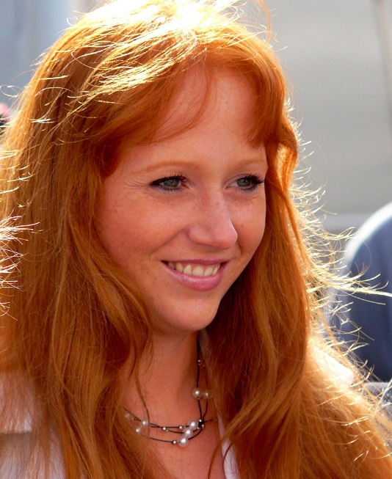
How old is she?
48
She’s forty-eight.

Slide 5

How old is he?
33
He’s thirty-three.

Slide 6
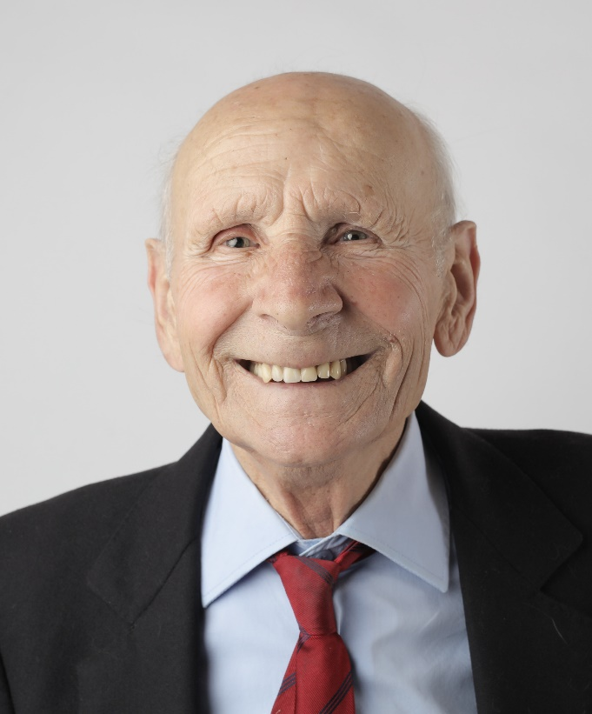
How old is he?
90
He’s ninety.

Slide 7
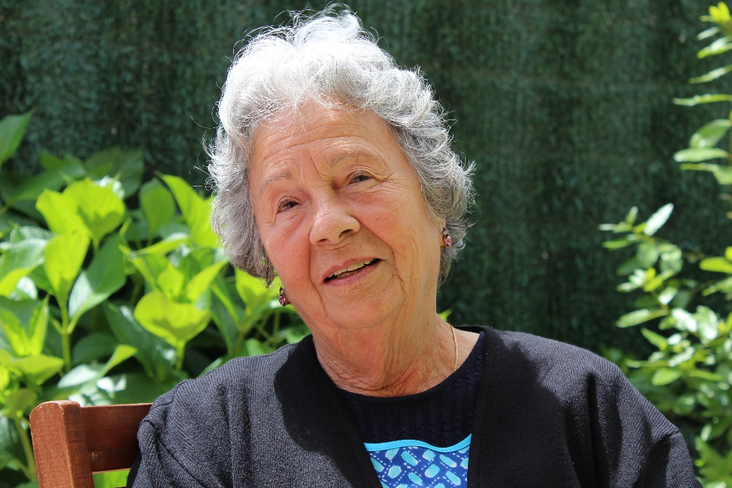
How old is she?
77
She’s seventy-seven.

Slide 8
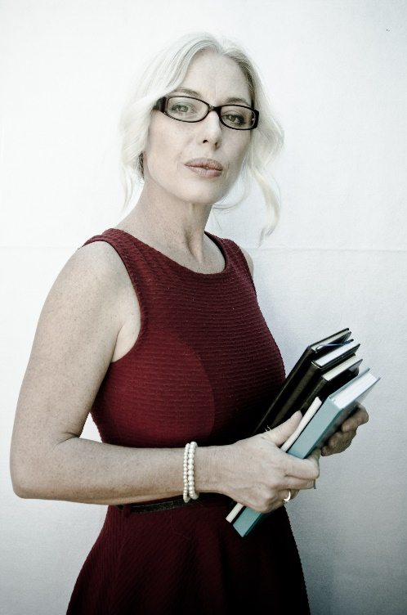
How old is she?
51
She’s fifty-one.

Slide 9
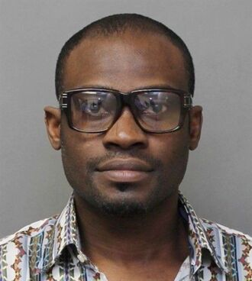
How old is he?
53
He’s fifty-three.

Slide 10

How old is he?
40
He’s forty.

Slide 11
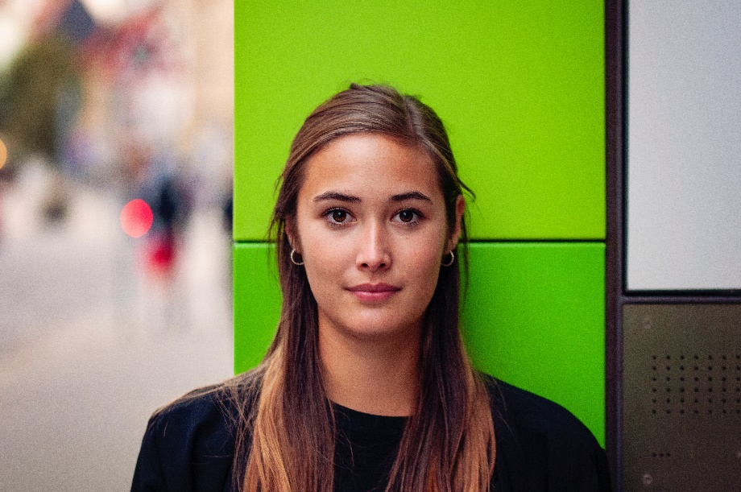
How old is she?
25
She’s twenty-five.

